Slide 1
ShopSmart
Shopping made Smart & Simple
App Developers:
Sneha Thomas, Ayleth Lozano, Isha Chawan, Tanya Sharma, Jingzhu Li

Slide 2
TABLE OF CONTENTS
Need for Shopping Assistant
Phase 1 App Prototype
01
05
Original Scheme
Challenges Anticipated
02
06
Early Adopter Feedback
Future Scope
03
07
Pivoted Feature Set
04

Slide 3




Need for a shopping assistant?
Lack of Product
Awareness &
Spend Patterns
Product Search -
Decision Fatigue
Price Comparison-
Tedious Process

Slide 4






Original Scheme
Initial customer segment: Students, Large families , Tourists , Busy Professionals
Price Comparison across popular stores
Ingredients, Nutrition & Calorie
content
Spend estimates
including taxes
Expiration, Allergen alerts
Weekly coupons, discounts
& deals
Verified Product
reviews

Slide 5
Early Adopter Feedback
Unclear Problem
Feature Overload
Customer Segment
A lack of overarching problem that connected all issues
Features involved in first stage were overwhelming and hard to achieve
The market directed at was too broad, each target having its own needs

Slide 6


Pivoted Feature Set
Phased Features Schedule
Targeted Customer Segment
Increase customer engagement and Validated Learning by rolling out features in multiple quarters/stages
Initial phase to cater to price-conscious segments of students and families with large grocery expenditure

Slide 7

Phase 1
App Prototype

Slide 8

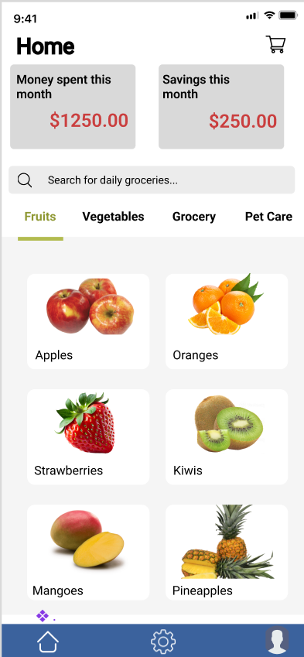

Home Page
Expenditure Dashboard
Product
Search
Product Recommendations
Navigation Bar

Slide 9
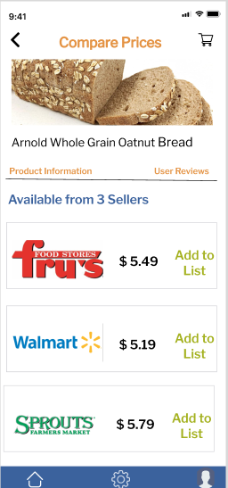
Price
Comparison
Shares options from multiple stores for the searched product
Add desired product
to Cart

Slide 10
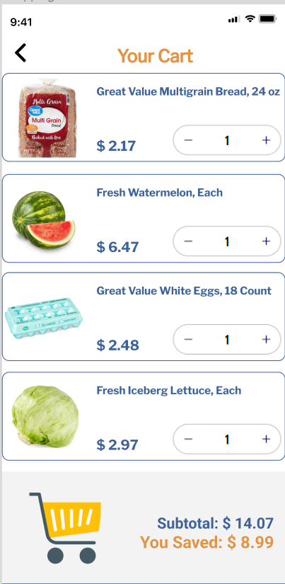
Shopping
Cart
All products added
to Cart
Total spend estimates including taxes

Slide 11
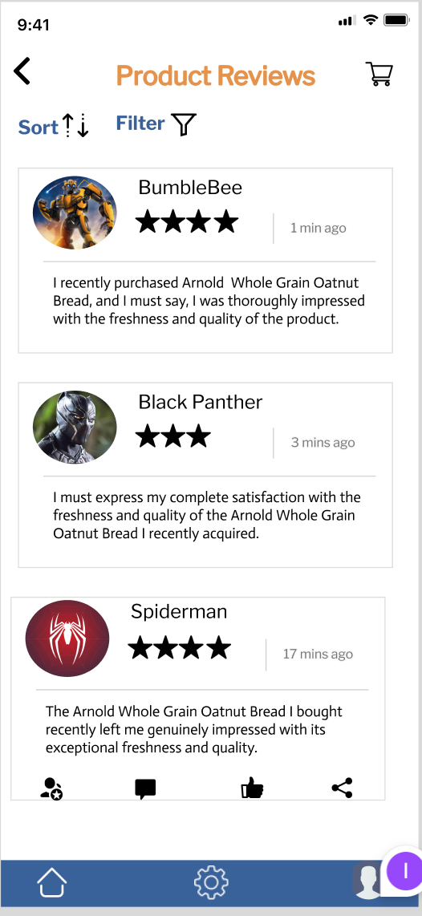
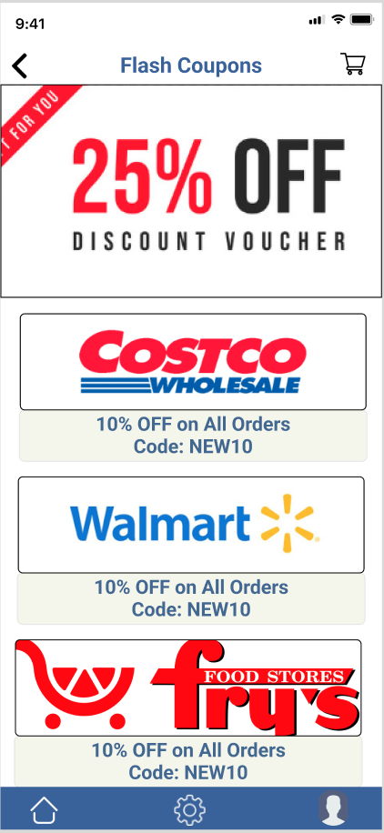
Deals/Discount & Reviews
Real-time reviews
Catered Discounts

Slide 12
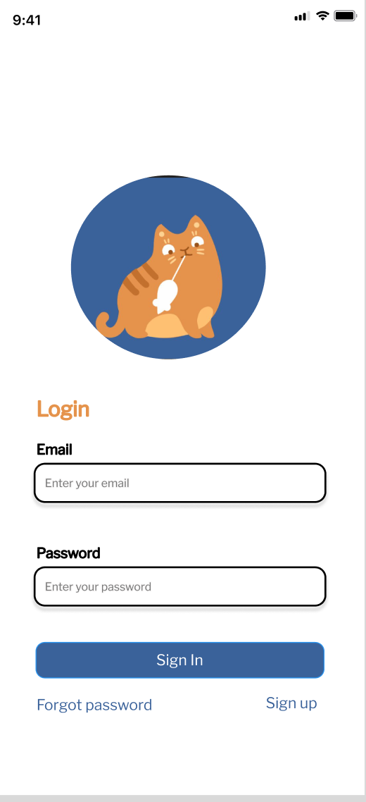
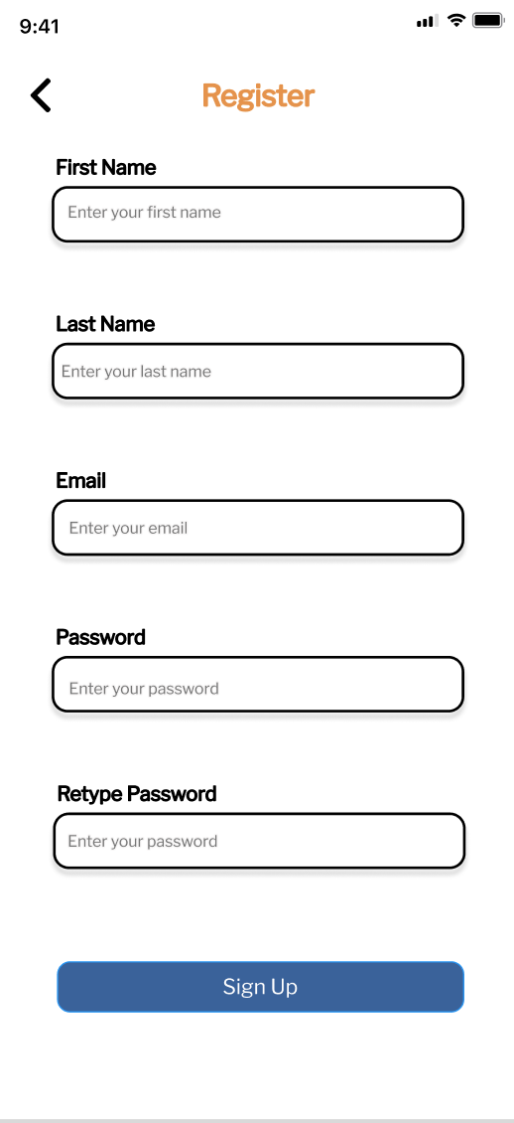
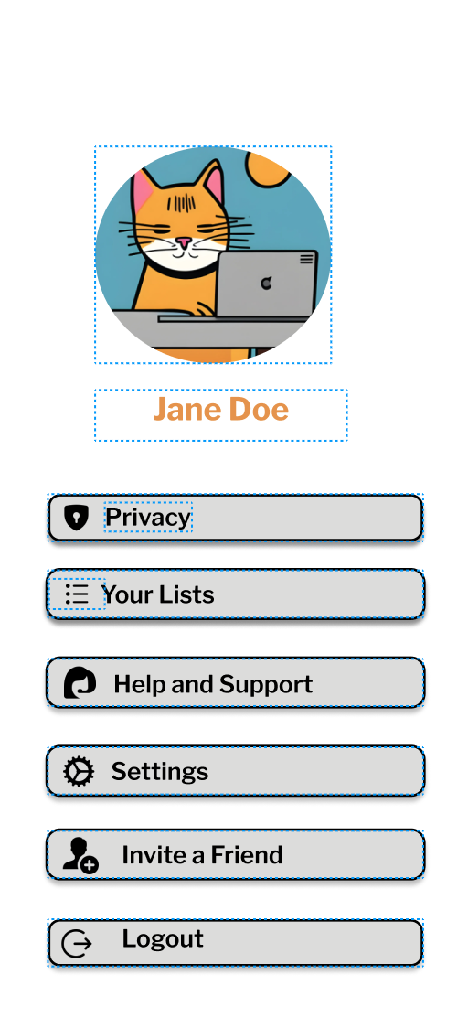
Profile Creation & Login Screen
Safety Measures
Easy Login

Slide 13




Challenges anticipated
Competitive
Landscape
Adoption & Engagement
Data privacy
& Security
Language &
Cultural adaptation
Notes:
Data Privacy and Security: Collecting and storing user data, especially sensitive information like personal preferences and payment details, raises concerns about data privacy and security. Ensuring compliance with data protection regulations, such as GDPR or CCPA, is crucial.
Language and Cultural Adaptation: If the shopping assistant is intended for a global audience, adapting it to different languages, cultures, and local shopping practices can be a significant challenge. Competitive Landscape: Staying competitive in a market where other businesses are also implementing shopping assistants can be a challenge. Offering unique features and superior customer experiences is essential.
Adoption and Engagement: The major premise of the app is the assumption that several big and small stores would be willing to partner with us and would see merit in our proposition. Also, convincing users to adopt the shopping assistant and engage with it regularly can be a challenge.

Slide 14


Future Scope
Phased Feature Launches
Health
& Wellness
Guidance
Global Expansion
Augmented Shopping
Notes:
Augmented Shopping: AR-enhanced shopping experiences can allow users to receive real-time product information, reviews, and discounts while physically shopping in stores.
Global Expansion: As e-commerce continues to expand globally, shopping assistants will adapt to different languages, cultures, and local shopping practices.
Health and Wellness Guidance: Shopping assistants can provide guidance on health and wellness products, personalized to a user's health goals and needs.

Slide 15

THANKS!

